Slide 1
Basketball shot trajectory reconstruction

Slide 2
The aim of this project was to reconstruct a basketball shot in 3D from a video
Can be used by basketball coaches and players to analyse their game

Slide 3
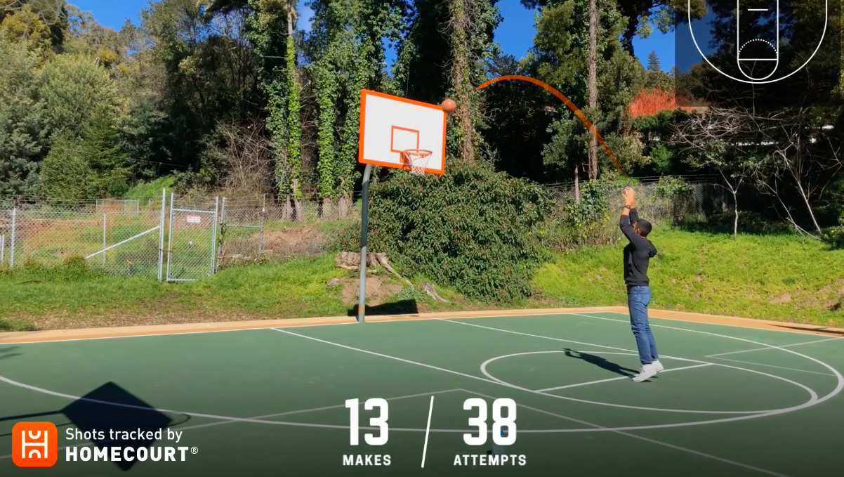
State of the art

Slide 4
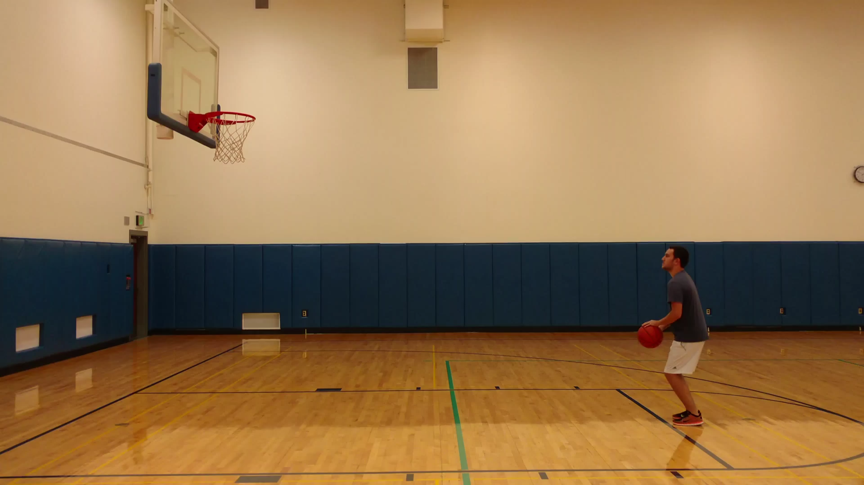

Slide 5
Solution approach
Using Matlab to detect the ball
Find camera projection matrix by selecting specific points from the court
Project ball positions to 3D space

Slide 6
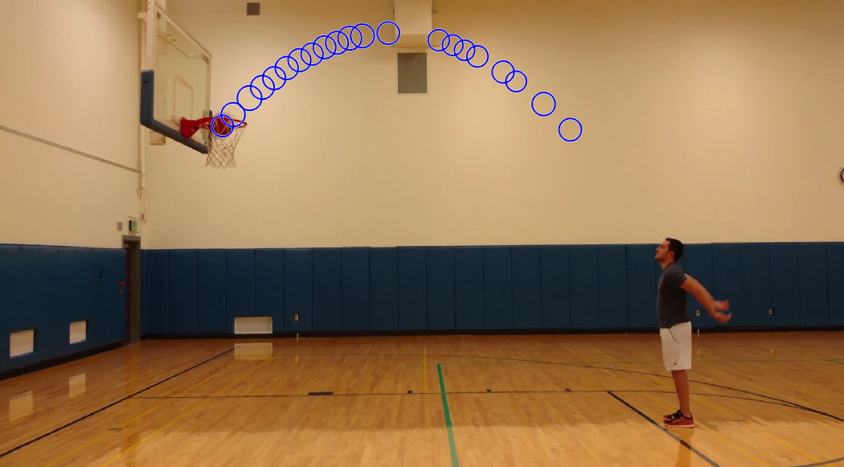
Ball detection
Ball detection

Slide 7
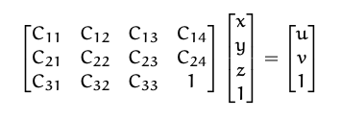
Camera projection matrix

Slide 8
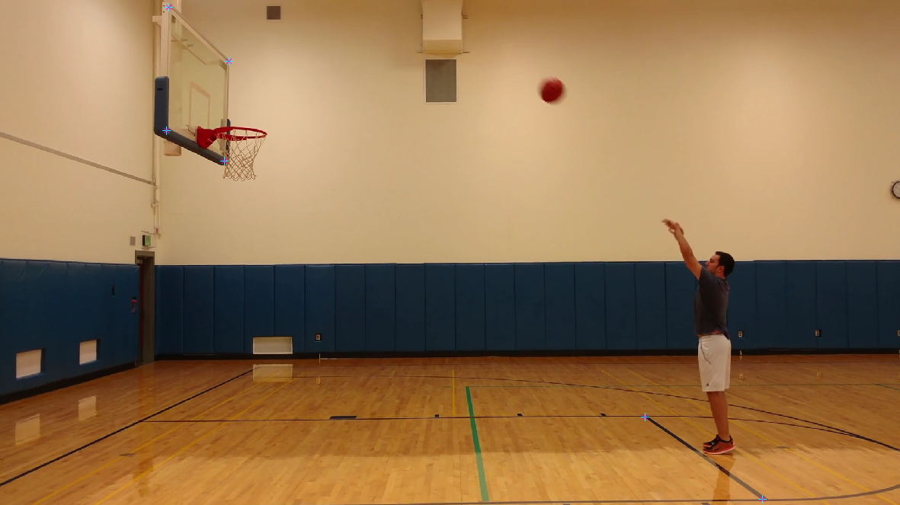

Slide 9
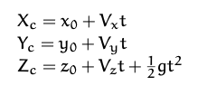
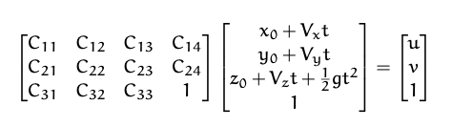
Parabolic trajectory in real world
Set up a matrix equation which we can solve

Slide 10
Results

Slide 11
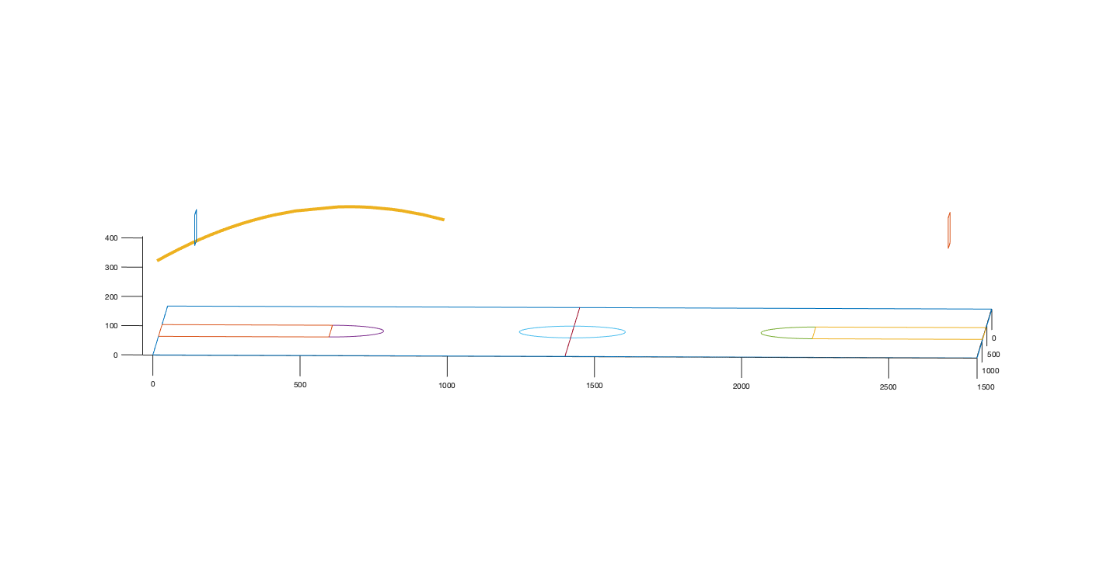

Slide 12
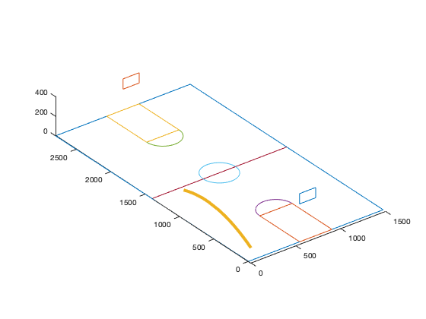

Slide 13
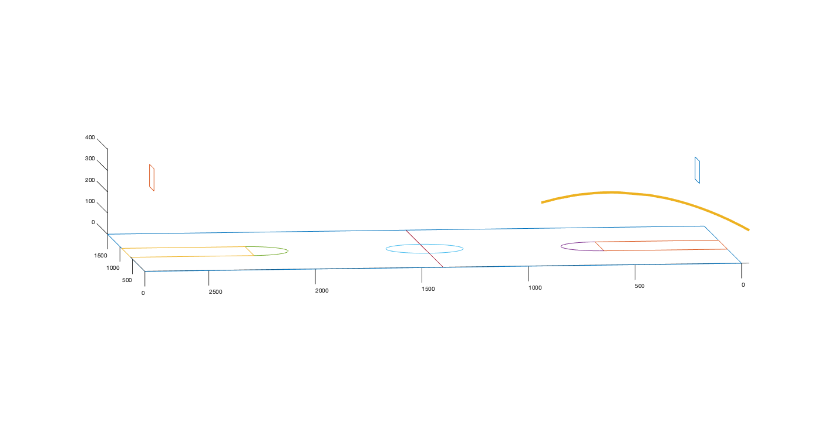

Slide 14
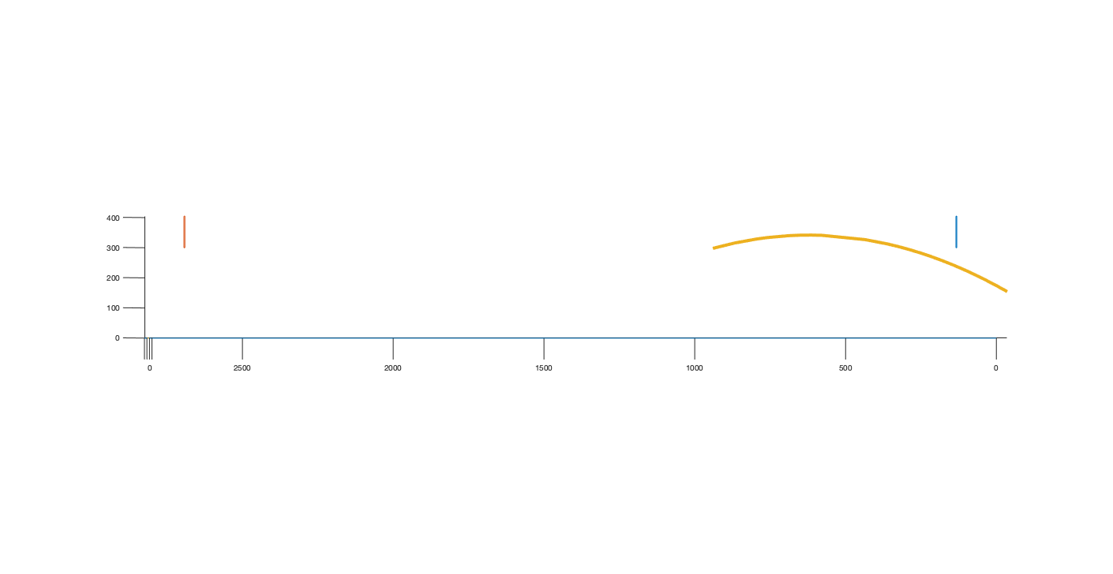

Slide 15
Notes about experiment
Air friction neglected
Video quality matters
Basketball court size might differ

Slide 16
Grazie

